Slide 1
Edge AI Deployment Pipeline for
Resource-Constrained Embedded Systems
M. Adil Nadeem | PSAU Research & Development Center | 6-27 August 2026

Slide 2
TABLE OF CONTENTS
01
Introduction & Project Overview
03-05
02
Research
06-15
03
Pipeline Architecture
16-18
04
Case Study: Real-Time Drone Detection – AMB82-mini
19–26
05
Case Study: Real-Time Drone Detection – Raspberry Pi Zero 2W
27–36
06
Performance Comparison
37–40
07
Lab Work
41–46
08
Challenges & Lessons Learned
47
09
Results, Key Takeaways & Conclusion
48–50
EDGE AI DEPLOYMENT PIPELINE

Slide 3
INTRODUCTION – EDGE AI
What Is Edge AI?
Edge AI runs inference directly on the device that captures the data — instead of sending it to a remote server.
Sensor / Camera
On-Device AI Model
Decision / Action
Captures raw data on-device (image, audio, motion, etc.)
Runs inference locally — no network round trip
Triggers a result: alert, label, control signal
No cloud round-trip required
Cloud AI vs. Edge AI
CLOUD AI
EDGE AI
Data leaves the device → travels the network → is processed on a remote server → response returns.
Higher latency, ongoing bandwidth cost, data leaves your control.
Sensing, inference, and action all happen on the device itself.
Low latency, works offline, raw data never has to leave the device.
EDGE AI DEPLOYMENT PIPELINE
03

Slide 4
MOTIVATION
Why Edge AI?
The case for pushing AI to the device itself, rather than the cloud:
Cloud inference needs constant connectivity — round-trip latency is often measured in hundreds of milliseconds.
Streaming raw sensor or camera data to the cloud costs bandwidth and increases privacy exposure.
Real-world use cases — industrial monitoring, wearables, smart cameras, autonomous systems — need decisions made locally, in real time, on limited power.
BLERP — Bandwidth • Latency • Energy • Reliability • Privacy
EDGE AI DEPLOYMENT PIPELINE
04

Slide 5
PROJECT DEFINITION
Project Scope & Objectives
SCOPE
OBJECTIVES
In scope
1
Research and document every pipeline stage, from problem definition to deployment
Define a reusable pipeline: problem → data → model → optimize → convert → deploy → run
Target hardware: ESP32, AMB82-Mini, Raspberry Pi Zero 2 W
Focus on classification-style edge inference tasks (vision / sensor data)
2
Analyze hardware capabilities and constraints across OS-based and firmware-only boards
3
Establish an optimization & conversion workflow for edge-ready models
4
Validate deployment feasibility on at least two embedded targets
5
Benchmark and evaluate real-time inference performance
Out of scope
Large-scale production MLOps / continuous retraining
Custom silicon or NPU-level firmware development
Performance enhancements or focus on specific scenario training
EDGE AI DEPLOYMENT PIPELINE
05

Slide 6
PROJECT FOUNDATIONS
Research Foundations Established
Before any custom deployment work began, the project's foundation was researched and documented across six areas.
✓
✓
✓
ML Problem Framing & Model Types
Dataset Sourcing & Custom Data
Preprocessing, Training & Evaluation
Classification vs. regression; supervised, unsupervised, RL, deep & generative models
Public dataset sources and a custom data collection / labeling workflow
Evaluation criteria and deployment constraints for edge-bound models
✓
✓
✓
Hardware Research
Optimization & Conversion
Toolchain Setup
Raspberry Pi Zero 2W, ESP32-WROOM-32U, AMB82-Mini — capabilities & limits
Quantization, pruning, ONNX, TensorFlow Lite Micro, NCNN
Environment setup and deployments on Edge Devices
EDGE AI DEPLOYMENT PIPELINE
06

Slide 7
RESEARCH: ARCHITECTURE FOUNDATIONS
The Machine Learning Pipeline for Edge AI
Every edge AI project follows the same general ML pipeline — with an added optimization step before deployment.
1
2
3
4
Identify Need & Scope
Data Collection
Data Cleaning & Analysis
Feature Extraction
Define the problem; cloud vs. edge
Gather raw sensor / image data
Fix errors, inspect for bias
Simplify inputs for smaller models
8
7
6
5
Operations & Maintenance
Deployment (Optimize + Convert)
Model Testing
Model Training
Monitor drift, retrain over time
Optimize & convert for target HW
Validate on held-out test data
Fit model to training data
Edge-specific step highlighted: optimization & conversion is what makes a model fit on constrained hardware.
EDGE AI DEPLOYMENT PIPELINE
07

Slide 8
RESEARCH: MODEL LANDSCAPE
Types of AI Models
Model choice depends on the task. A model can score high on accuracy and still be the wrong fit once deployment constraints are considered.
Model Type | Learning Approach | Example Techniques | Typical Applications
Supervised | Learns from labelled input/output pairs | Linear/Logistic Regression, Decision Trees | Credit scoring, spam detection
Unsupervised | Finds patterns in unlabelled data | Clustering, Dimensionality Reduction | Customer segmentation, anomaly detection
Reinforcement | Learns via trial, reward & penalty | Reinforcement learning agents | Autonomous vehicles, inventory optimization
Deep Learning | Learns hierarchical representations | CNNs, RNNs | Image recognition, time-series, voice
Generative AI | Learns patterns to generate new content | GANs, Large Language Models | Text/content generation, summarization
EDGE AI DEPLOYMENT PIPELINE
08

Slide 9
RESEARCH: DATA
Building the Right Dataset
Two paths into a training-ready dataset — public sources or a custom capture pipeline.
Public Datasets
Kaggle, Roboflow Universe, TensorFlow Datasets, HuggingFace Datasets, UCI ML Repository etc.
Labeling
Cleaning & Augmentation
Preprocessing
Training-Ready Dataset
Tag samples with ground-truth classes
Remove errors/duplicates; expand variety
Normalize, resize, extract features
Split into train / validation / test sets
Custom Collection
Capture data with the same sensor/device you plan to deploy on, in the target environment
Best practice: collect data using the same device and sensors you plan to ultimately deploy to — a model trained on smartphone photos may not generalize to a low-power embedded camera.
EDGE AI DEPLOYMENT PIPELINE
09

Slide 10
RESEARCH: MODEL EVALUATION
How Do We Know a Model Is Good?
A model can post excellent accuracy and still perform poorly in practice — evaluation has to match the task.
Classification Metrics
Regression Metrics
Metric | What It Tells You
Accuracy | Correct predictions ÷ total predictions
Precision | Of predicted positives, how many were actually correct — minimizes false positives
Recall | Of actual positives, how many were correctly found — minimizes false negatives
F1 Score | Harmonic mean of precision & recall — useful for imbalanced data
Metric | What It Tells You
MAE | Mean Absolute Error — average absolute gap between actual & predicted values; same unit as target, easy to interpret
MSE | Mean Squared Error — averages squared differences; penalizes large errors more heavily, sensitive to outliers
Why it matters
Accuracy alone can't capture model quality. High recall matters in healthcare (don't miss positives); high precision matters in fraud detection (don't cry wolf).
Task type comes first: classification metrics for discrete labels, regression metrics for continuous outputs.
EDGE AI DEPLOYMENT PIPELINE
10

Slide 11
RESEARCH: MODEL EVALUATION
Evaluation for Edge Deployment
On embedded hardware, task accuracy is only half the picture — efficiency metrics decide whether a model can even run.
Metric | What It Measures | Why It Matters at the Edge
Inference Latency | Time to process a single input (ms / µs) | Determines real-time responsiveness
Throughput | Inputs processed per second (IPS / FPS) | Handles continuous sensor or camera streams
Energy Consumption | Power drawn during inference (W / mW) | Governs battery life and thermal limits
Memory Usage | RAM required during inference (KB / MB) | Must fit within the MCU / SoC's tight memory budget
A systematic review of neural-network deployment on embedded systems identifies these four as the key inference evaluation metrics for edge AI.
EDGE AI DEPLOYMENT PIPELINE
11

Slide 12
RESEARCH: OPTIMIZATION
Shrinking Models to Fit the Edge
QUANTIZATION
CONVERSION PIPELINE
Reduces the numeric precision of weights & activations — e.g. 32-bit floating point (FP32) → 8-bit integer (INT8).
1
Trained Model
TensorFlow / PyTorch
INT8 quantization → roughly 4× smaller model size, faster integer math on MCU hardware, small accuracy trade-off
Post-Training Quantization (PTQ): applied after training, fast to apply
Quantization-Aware Training (QAT): simulated during training, higher accuracy, more effort
2
ONNX
Common interchange format
3
TFLite Micro / NCNN
Also studied: pruning — removing less-important weights/nodes from the network to further shrink model size and compute cost.
MCU (ESP32) or ARM-optimized (Pi / AMB82) runtime
4
Flashed to Device
Ready for on-device inference
EDGE AI DEPLOYMENT PIPELINE
12

Slide 13
RESEARCH: HARDWARE
Comparing the Target Hardware
Spec | Raspberry Pi Zero 2 W | ESP32-WROOM-32U | AMB82-Mini
Type | SBC — runs an OS | MCU — firmware only | MCU + NPU — firmware only
CPU | Quad-core ARM Cortex-A53 @ 1 GHz | Dual-core Xtensa LX6 @ 80–240 MHz | Arm v8M @ up to 500 MHz
AI Accelerator | None (CPU-only) | None (CPU-only) | NPU @ 0.4 TOPS
Memory | 512 MB LPDDR2 RAM | ~520 KB SRAM, 4 MB flash | 512 KB RAM, 16 MB flash (+ up to 128 MB opt. DDR)
OS / Runtime | Linux (Raspberry Pi OS) | None – RTOS / bare-metal | None – RTOS (Arduino / RTOS / IAR / GCC)
Camera | Via CSI / USB (external) | External module needed | External module JX-F37: 2MP, 1080p, 130° FOV
Connectivity | Wi-Fi 2.4GHz + BT 4.2 | Wi-Fi + BT 4.2 | Dual-band Wi-Fi + BLE 5.1
Takeaway: OS-based boards trade power/simplicity for flexibility; firmware-only boards run leaner and cheaper but demand far more manual optimization.
EDGE AI DEPLOYMENT PIPELINE
13

Slide 14
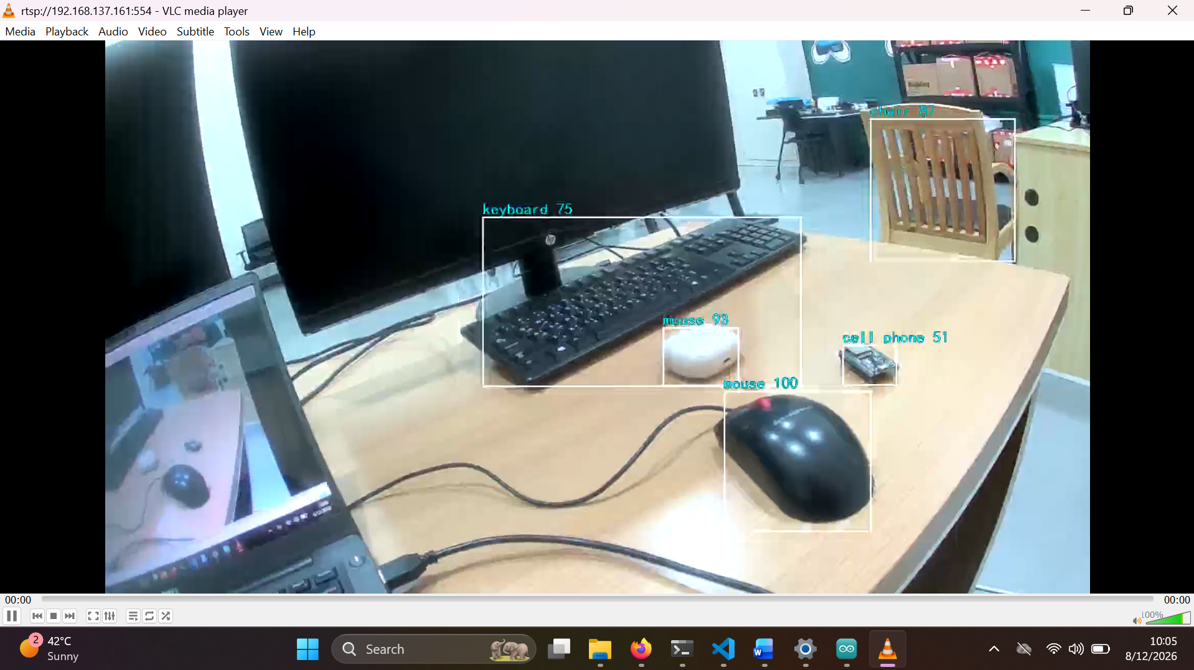
RESEARCH: HANDS-ON
Experimentation: Environment Setup & First Deployments
AMB82-Mini (+ JX-F37 Camera Module)
1
Arduino IDE + Ameba SDK
Installed board package via Boards Manager URL
2
Ran example sketches
LED blink to validate the toolchain, then camera examples including object detection example sketch
3
HTTP video streaming
Verified camera + Wi-Fi pipeline by streaming live video to a browser
EDGE AI DEPLOYMENT PIPELINE
14

Slide 15
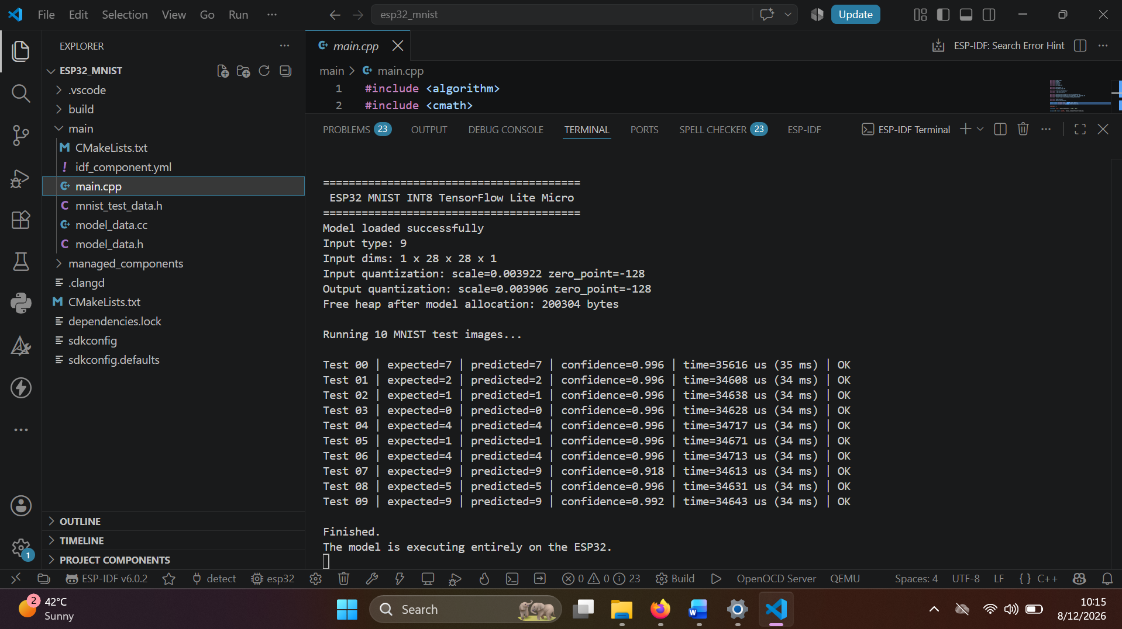
RESEARCH: HANDS-ON
Experimentation: Environment Setup & First Deployments
ESP32-WROOM-32U
1
Arduino IDE — attempted first
Toolchain/deployment issues; sketch would not build/run reliably on the board
2
Switched to ESP-IDF
Espressif's official SDK, configured via the VS Code extension
3
Success
Built and flashed AI inference code; verified live output on the serial monitor
EDGE AI DEPLOYMENT PIPELINE
15

Slide 16
PROPOSED ARCHITECTURE
The Pipeline Behind the Project
This two-part architecture is the framework the case study (next) puts into practice.
BUILD-TIME
Problem
Definition
Data Collection
& Prep
Model
Training
Evaluation
Optimization
Conversion
Flash to
Device
RUN-TIME LOOP
Sensor / Camera
Input
Pre-
processing
Model
Inference
Post-
Processing
Output /
Action
The case study that follows walks this exact architecture end-to-end: a real problem, a real dataset, a trained model, optimization, conversion, deployment, and a live run-time loop — all on the target device.
EDGE AI DEPLOYMENT PIPELINE
16

Slide 17
PROPOSED ARCHITECTURE
BUILD-TIME / OFFLINE
Pipeline Architecture — Build-Time
What happens once, before anything is flashed to a device.
1
2
3
4
5
6
7
Problem
Definition
Data Collection
& Preprocessing
Model
Training
Evaluation
Optimization
Conversion
Flash to
Device
Classification or regression?
Gather, clean, prepare data
Fit model on training data
Accuracy, precision, recall, MAE/MSE
Quantize, prune for target HW
ONNX → TFLite Micro / NCNN
Deploy binary to embedded target
This is the reusable architecture at the core of the internship project — designed to generalize across different target boards and tasks.
EDGE AI DEPLOYMENT PIPELINE
17

Slide 18
PROPOSED ARCHITECTURE
RUN-TIME / ON-DEVICE LOOP
Pipeline Architecture — Run-Time
What runs continuously, in real time, once the model is on the device.
1
2
3
4
5
Sensor / Camera Input
Preprocessing
Model Inference
Post-Processing
Output / Action
Capture raw data on-device
Resize, normalize, extract features
Run the optimized model on-device
Interpret raw model output
Alert, display, or actuate
Loops continuously in real time — this is the cycle the pipeline must sustain under hardware constraints
EDGE AI DEPLOYMENT PIPELINE
18

Slide 19
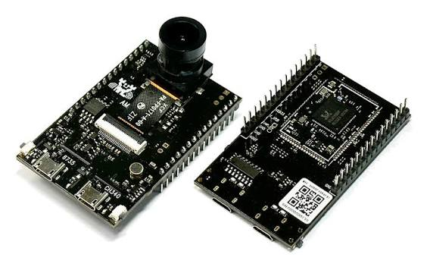
CASE STUDY – AMB82-MINI
Real-Time Drone Detection on AMB82-Mini
A custom single-class detector — trained from scratch, converted, and verified live — validating the proposed pipeline end-to-end.
AMB82-Mini + JX-F37 camera
Pipeline Stage | What Was Done Here
Problem Definition | Single-class object detection (“drone”), real-time, on-device
Data Collection | Public Kaggle drone-detection dataset, pre-split train/valid, YOLO format
Model Training | YOLOv7-tiny (PyTorch), trained on Kaggle (GPU)
Evaluation | test.py / detect.py against the validation split
Optimization & Conversion | Reparameterization + AmebaPro2 online model conversion to .nb
Flash to Device | Arduino IDE + Ameba Pro2 SDK, ObjectDetectionLoop example
Run-Time Loop | On-device inference → RTSP stream → verified live in VLC
EDGE AI DEPLOYMENT PIPELINE
19

Slide 20
CASE STUDY — DATA
Training Data: Kaggle YOLO Drone Dataset
Public, pre-labeled dataset in YOLO format — no custom collection was needed for this first pass.
Property | Value
Source | Kaggle — “YOLO Drone Detection Dataset” (muki2003)
Classes | 1 (drone)
Format | YOLO — images/ + labels/, normalized .txt per image
Split | Pre-split train / valid
Input size used | 320 × 320
YOLO LABEL FORMAT
drone
class x_center y_center width height
0 0.482 0.531 0.221 0.187
Why a public dataset first
Using a ready-made, pre-labeled dataset let the full pipeline — training through live deployment — be validated quickly, before investing time in custom data collection.
One normalized .txt label per image — class index plus a center-point bounding box.
EDGE AI DEPLOYMENT PIPELINE
20

Slide 21
CASE STUDY — TRAINING
Training Environment & Approach
⚠ FINDING
A local, GPU-less Windows machine failed on reparameterization due to a PyTorch dependency conflict. Kaggle's free GPU notebooks worked without issue — training (and later reparameterization) needs a GPU-backed PyTorch environment.
TWO TRAINING APPROACHES COMPARED
Approach | Description | Outcome
A — 100 Epochs, From Scratch | YOLOv7-tiny trained with no pretrained weights, full 100 epochs on Kaggle GPU | Baseline comparison run
B — 50 Epochs, Fine-Tuned | Started from official YOLOv7-tiny COCO-pretrained weights, fine-tuned for 50 epochs | Selected for deployment
CONFIGURATION NOTES
Class count changed from 80 (default COCO) to 1 (“drone”) in the training config
A 1-epoch sanity check confirmed the pipeline end-to-end before committing to full training
EDGE AI DEPLOYMENT PIPELINE
21

Slide 22
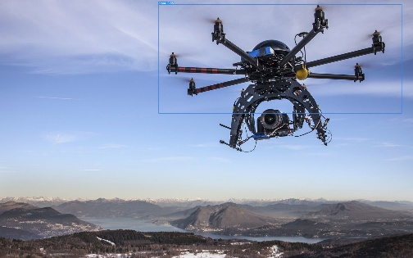
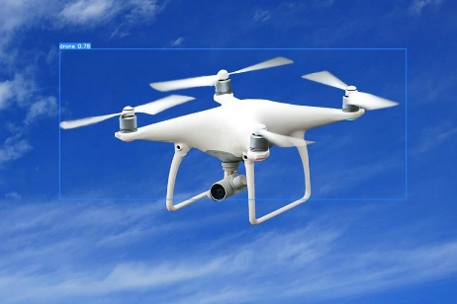
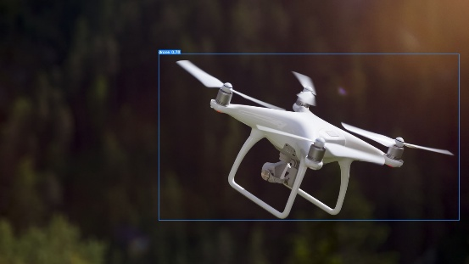
CASE STUDY — VALIDATION
Validating Detection Quality
Two checks were used before moving to deployment: numbers from test.py, and a visual sanity check from detect.py.
Quantitative — test.py
Visual — detect.py
Run against the held-out validation split to compute precision, recall, and mAP.
Run across the full validation image set to visually inspect bounding boxes, not just metrics.
SAMPLE DETECTIONS ON VALIDATION IMAGES
Bounding box + confidence score drawn by detect.py on unseen validation images
EDGE AI DEPLOYMENT PIPELINE
22

Slide 23
CASE STUDY — OPTIMIZATION
From Trained Weights to Board-Ready Model
Uses AmebaPro2 Online Conversion Tool to convert trained model weights to board-native format
1
2
4
5
Trained Model Weights
Reparameterization
AmebaPro2 Online
Conversion Tool
.nb Model File
Fine-tuned YOLOv7-tiny weights
Additional step for pytorch trained model conversion
Converts PyTorch weights to board-native format
Ready to flash to the AMB82-Mini
⚠ Other Supported Frameworks & Models
Beyond PyTorch YOLOv7-Tiny, Realtek's conversion tool natively supports Darknet (YOLOv3/v4/v7), ONNX (SCRFD / MobileFaceNet), and Keras/TensorFlow (YAMNet & CNNs)
MODEL CONVERSION OPTIONS
Online tool (used here)
Offline tool (alternative)
Upload the reparameterized model to Realtek's AmebaPro2 web converter
Local conversion, documented by Realtek, for cases where uploading isn't desired
EDGE AI DEPLOYMENT PIPELINE
23

Slide 24
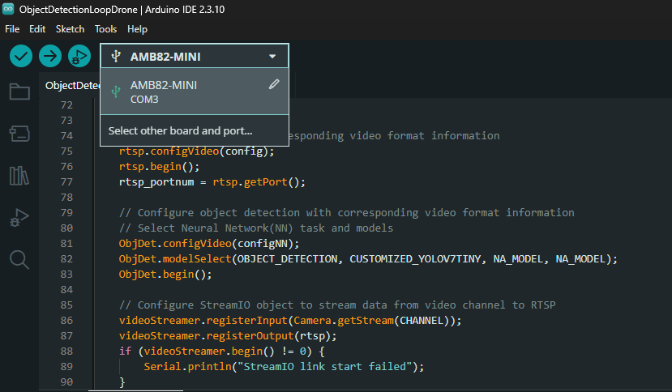
CASE STUDY — DEPLOYMENT
Flashing the Custom Model
Getting the .nb file and an adapted example sketch onto the board.
1
Place the .nb model file
Either directly inside the ObjectDetectionLoop example folder, or in a separate sketch folder alongside it — both placements work; no SD card needed
2
Adapt the example sketch
Point the sketch at the custom .nb file, and reduce the class list from the stock 80-class COCO set down to the single “drone” class
3
Select board, port & upload
Tools → Board: AMB82-Mini, Tools → Port: its COM port, then Upload and wait for compile + flash
Arduino IDE — board/port selection with the adapted ObjectDetectionLoopDrone sketch
Practical tip: excluding the Arduino15 SDK folder from Windows Defender avoided slow/unreliable compiles on this large SDK tree.
EDGE AI DEPLOYMENT PIPELINE
24

Slide 25
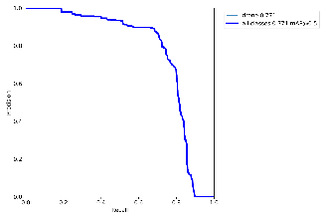
CASE STUDY — RESULTS
Model Performance
Measured on the held-out validation split after training.
0.771
0.78
1.00
0.89
mAP@0.5
Best F1 Score
Peak Precision
Peak Recall
Mean Average Precision at IoU 0.5
At confidence threshold 0.551
At confidence threshold 0.918
At low confidence thresholds
What these numbers mean in practice
Precision–Recall Curve
mAP@0.5 = 0.771
Detection accuracy was limited by dataset size — occasional false positives/negatives that additional training data would reduce
Live video playback was functional but slightly uneven — not perfectly smooth, though acceptable for tracking use cases
This is a real, custom-trained model — not a bundled example — correctly detecting a single object class it was never explicitly shown during the AMB82-Mini's factory setup.
EDGE AI DEPLOYMENT PIPELINE
25

Slide 26
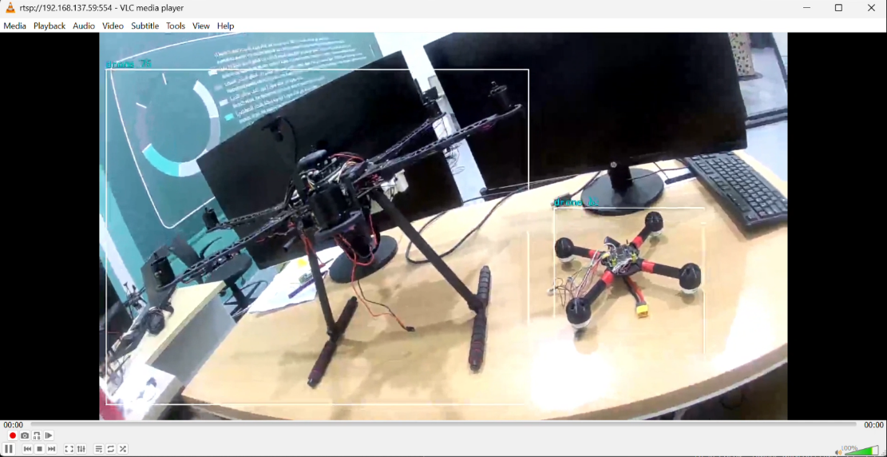
CASE STUDY — LIVE DEMO
Seeing It Work: Live RTSP Detection
HOW IT'S VIEWED
1
Board resets and joins Wi-Fi — watched live on the Serial Monitor
2
Serial Monitor prints the board's IP address and RTSP port (default 554)
3
VLC → Media → Open Network Stream, on the same network
4
Enter rtsp://<board-ip>:<port>/ and press Play
5
Live feed appears with a bounding box + label around any drone in frame
SERIAL MONITOR
> Total objects detected: 1
> RTSP URL: rtsp://192.168.137.59:554
Two real drones on the bench, both detected live — RTSP stream viewed in VLC
EDGE AI DEPLOYMENT PIPELINE
26

Slide 27
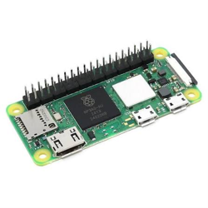
CASE STUDY · RASPBERRY PI ZERO 2 W
Real-Time Drone Detection on the Raspberry Pi Zero 2 W
Deploys the same trained YOLOv7-tiny weights used in the AMB82-Mini case study onto a Raspberry Pi Zero 2 W.
Uses NCNN — an open-source, CPU-oriented inference framework — instead of a dedicated NPU toolchain.
Goal: reproduce the full edge pipeline and benchmark CPU-only performance.
END-TO-END PIPELINE
🖼
1
2
3
4
5
Image placeholder: Raspberry Pi Zero 2 W + USB camera setup photo
USB Camera
Letterbox
NCNN Inference
NMS
MJPEG Stream
EDGE AI DEPLOYMENT PIPELINE
27

Slide 28
CASE STUDY · STACK
Hardware and Software Used
Component | Detail
Board | Raspberry Pi Zero 2 W
OS | Ubuntu 22.04.5 LTS (Jammy), aarch64
CPU / RAM | 4-core CPU; ~414 MB usable RAM; 0 B swap (default)
Camera (attempted → used) | Pi Camera Module 2 / IMX219 (CSI) → USB webcam (UVC/V4L2)
Inference runtime | NCNN — built from source, Python bindings
Model | YOLOv7-tiny, single class ("drone"), same weights as AMB82-Mini
Application stack | Python 3.10, OpenCV, NumPy, Flask (MJPEG HTTP stream)
EDGE AI DEPLOYMENT PIPELINE
28

Slide 29
CASE STUDY · MODEL CONVERSION
Model Conversion Pipeline
Same best.pt checkpoint as the AMB82-Mini case study — reused, not retrained.
Exported PyTorch → ONNX (YOLOv7 tooling), then converted ONNX → NCNN (PNNX).
Output: best.ncnn.param (graph) + best.ncnn.bin (weights) — both required at runtime.
1
2
3
4
best.pt
best.onnx
PNNX/NCNN
best.ncnn
PyTorch
ONNX export
conversion
.param + .bin
Same weights as AMB82-Mini — only the export target changes.
EDGE AI DEPLOYMENT PIPELINE
29

Slide 30
CASE STUDY · CAMERA CHALLENGE
Key Engineering Challenges
CAMERA: CSI → USB WEBCAM
BUILDING NCNN FROM SOURCE
CSI/IMX219 captured raw Bayer frames fine, but Ubuntu 22.04's outdated libcamera stack couldn't decode them to RGB/YUV.
Rebuilding libcamera from source hit further blockers — abandoned as too costly.
Switched to a USB webcam: MJPEG/YUYV works natively with cv2.VideoCapture(..., CAP_V4L2).
No prebuilt NCNN package existed for this target — compiled from source (NCNN_PYTHON=ON, NCNN_VULKAN=OFF).
~414 MB RAM, 0 swap: added a 2GB swap file, built single-threaded (make -j1) to avoid OOM.
Compiled .so wasn't auto-importable — PYTHONPATH set explicitly and persisted in ~/.bashrc.
EDGE AI DEPLOYMENT PIPELINE
30

Slide 31
CASE STUDY · DETECTION ARCHITECTURE
Detection Application Architecture
1
2
3
4
5
6
Camera Capture
Letterbox
NCNN Inference
NMS + Decode
Draw + FPS
Flask MJPEG
640×480
320×320
in0 → out0
6300×6
overlay
:8080
Model I/O
Postprocessing
Threading
320×320 input (in0) → 6300×6 output (out0); 3 heads: 40×40, 20×20, 10×10
Confidence filter → box decode → undo letterbox → cv2.dnn.NMSBoxes
Capture + inference on a daemon thread, decoupled from the Flask server thread
EDGE AI DEPLOYMENT PIPELINE
31

Slide 32
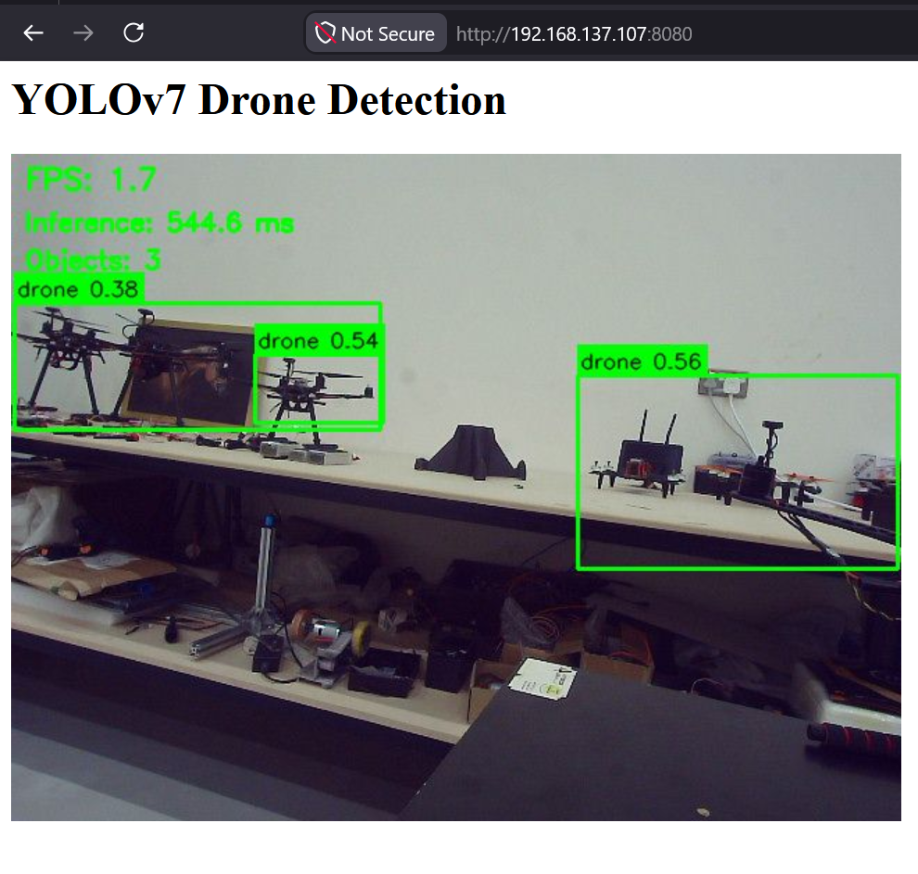
CASE STUDY · RESULTS
Live Detection Results
1.7–1.8
500ms+
3
FPS (end-to-end)
inference / frame
objects detected
Detection accuracy: good at close range
Model correctly localised and classified drones at reasonable confidence (0.38–0.56).
Pipeline verified end-to-end: camera → NCNN inference → NMS → live MJPEG stream.
Throughput, not accuracy, is the current bottleneck.
Live MJPEG stream — three drones correctly detected (confidences 0.38, 0.54, 0.56).
EDGE AI DEPLOYMENT PIPELINE
32

Slide 33
CASE STUDY · PERFORMANCE OPTIMIZATTION
Performance Optimization Roadmap
ROOT CAUSES
RECOMMENDED NEXT STEP
CPU-only Cortex-A53, no NPU/GPU path exercised.
Model is NPU-tuned for AMB82-Mini, reused unmodified.
Switch to a smaller/faster architecture (YOLOv5n, YOLOv8n etc) trained/exported for this deployment
Then try using frame-skipping or reducing camera capture quality
Option | Expected Impact
Reduce camera capture resolution | Cuts preprocessing (resize/color-convert) cost per frame; minor but free win
Smaller input (256²/192²) | ~Quadratic compute reduction
Nano model (YOLOv5n/v8n) | Purpose-built for CPU/edge SBCs
Frame-skipping | No model change; smoother stream
A natural comparison point: NPU-accelerated inference (AMB82-Mini) vs. optimized CPU inference (Raspberry Pi Zero 2 W).
EDGE AI DEPLOYMENT PIPELINE
33

Slide 34
CASE STUDY · PERFORMANCE ITERATION
Performance Iteration: Fine-Tuning YOLO11n
TRAINING SETUP
Same dataset reused: 1,012 train / 347 val images, single class “drone”.
yolo11n.pt (COCO-pretrained) fine-tuned via transfer learning — Kaggle, Tesla T4 GPU.
imgsz=320, batch=16, patience=20; stopped early at epoch 85 (best @ 65), ≈ 15.5 min total.
Acts directly on the two Section 9.9 recommendations: nano architecture + reduced per-frame compute.
TRAINING RESULTS (VALIDATION SET)
Metric | Value
Precision | 0.896
Recall | 0.816
mAP@50 | 0.896
mAP@50–95 | 0.539
EDGE AI DEPLOYMENT PIPELINE
34

Slide 35
CASE STUDY · PERFORMANCE ITERATION
Model Export & Application Updates
EXPORT: PYTORCH → NCNN
FRAME-SKIPPING AND REDUCE CAMERA CAPTURE RESOLUTION: TRIED, THEN REMOVED
Artifact | .param | .bin
best.pt (PyTorch) | — | ---
NCNN FP32 | 0.02 MB | 9.88 MB
NCNN FP16 (exported, unused) | 0.02 MB | 4.96 MB
An earlier iteration added frame-skipping (running inference only every Nth frame, reusing the last detection in between) to cut how often the expensive inference step runs.
In practice this was found impractical for real-time detection of fast-moving UAVs — a skipped frame can miss a drone that has already moved out of its previous position by the time it's redrawn.
Frame-skipping has been removed; every measured result going forward runs inference on every frame (“Skip: 1” on the overlay).
Also, reducing camera capture resolution reduces quality and accuracy making it impractical
APPLICATION CHANGES
Separate Stream FPS / Inference FPS tracking on the overlay.
Thresholds tightened: CONF 0.25→0.45, NMS 0.45→0.55.
EDGE AI DEPLOYMENT PIPELINE
35

Slide 36
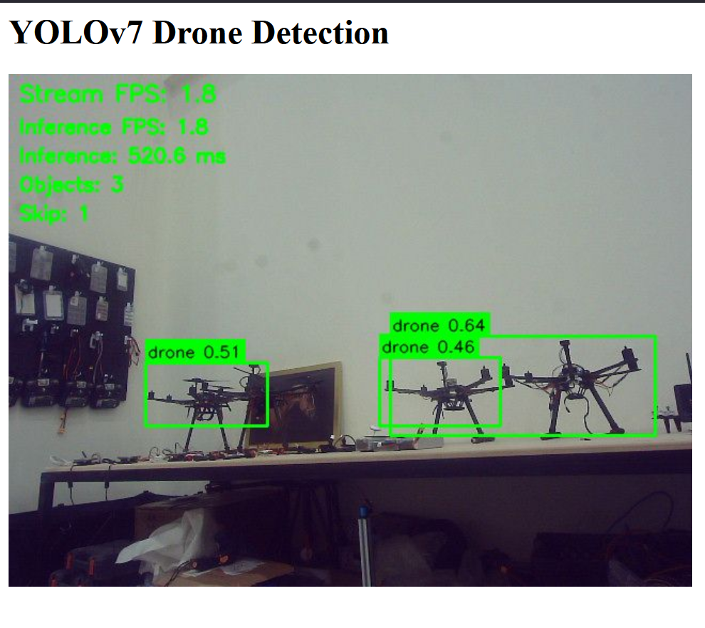
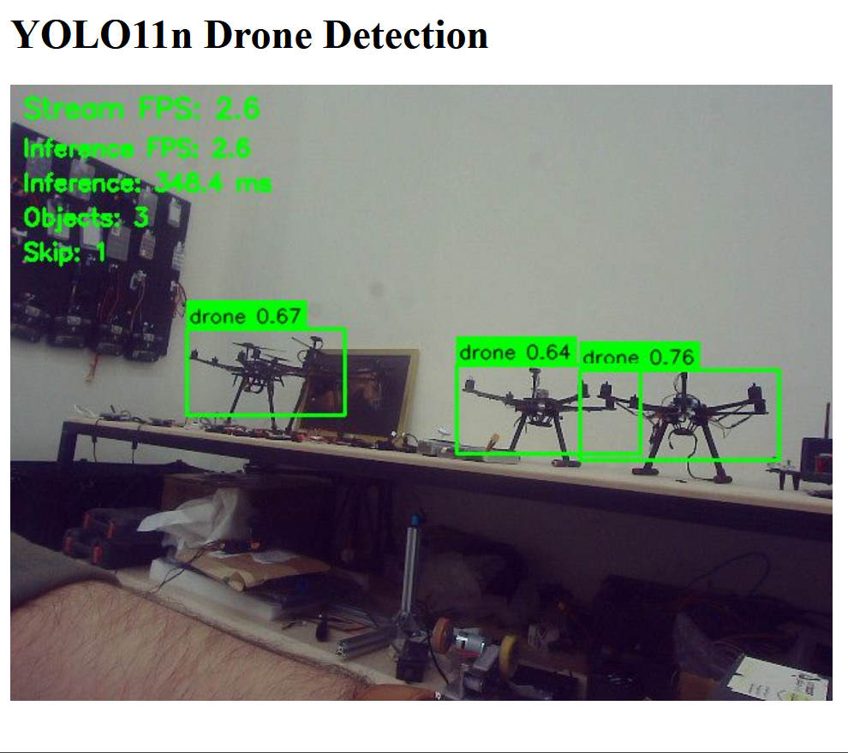
CASE STUDY · PERFORMANCE ITERATION
On-Device Results: YOLOv7-tiny vs. YOLO11n
+~40%
−~35%
higher FPS
inference time
Still behind the AMB82-Mini
Even at ~2.6–2.8 FPS, the Pi/YOLO11n combination remains roughly 2.5–2.7× slower than the AMB82-Mini's approximate ~7.06 FPS (Benchmarking section) — the CPU-vs-NPU gap dominates over the model-choice gain.
YOLOv7-tiny (original)
YOLO11n (fine-tuned)
Metric | YOLOv7-tiny | YOLO11n
FPS (measured) | ~1.7–1.8 | ~2.6–2.8
Inference time | ~500–545 ms | ~300–350 ms
Frame-skipping | No | No (removed — see prior slide)
EDGE AI DEPLOYMENT PIPELINE
36

Slide 37
COMPARISON · OVERVIEW & METHODOLOGYCASE
Benchmarking: AMB82-Mini vs. Raspberry Pi (2 Models)
Three configurations compared: AMB82-Mini (NPU) and Raspberry Pi (CPU) both on YOLOv7-tiny, plus the Pi on a separately fine-tuned YOLO11n.
Isolates two effects: hardware (NPU vs. CPU, same model) and model/training choice (same Pi hardware, two models).
Not a controlled, identical-conditions benchmark — each configuration was measured with whatever instrumentation was available.
AMB82-MINI
PI — YOLOV7-TINY
PI — YOLO11N
Dedicated NPU (RTL8735B)
YOLOv7-tiny → Realtek .nb
Native, hardware-matched toolchain
CPU-only (Cortex-A53)
NCNN FP32, reused as-is
No CPU-specific tuning
CPU-only (Cortex-A53)
NCNN FP32, fine-tuned nano model
Frame-skipping tried, then removed
EDGE AI DEPLOYMENT PIPELINE
37

Slide 38
COMPARISON · MEASUREMENT APPROACH
Measuring Inference Speed — Three Configurations
AMB82-MINI — NN LOG
PI — YOLOV7-TINY
PI — YOLO11N
Async NPU inference — no app-level hook. NN runtime debug log used instead:
detector.py times inference directly with time.time() around NCNN extractor.extract().
Same direct-timer method, fine-tuned model, inference on every frame (frame-skip removed).
~7.06
1.7–1.8
2.6–2.8
FPS (approx.)
FPS
FPS
~142ms
500–545ms
300–350ms
derived (1÷FPS)
inference/frame
inference/frame
Indirect / approximate
Direct / measured
Direct / measured
EDGE AI DEPLOYMENT PIPELINE
38

Slide 39
COMPARISON · RESULTS & EXPLANATION
Side-by-Side Comparison & Why the Gaps Exist
Metric | AMB82-Mini (YOLOv7-tiny) | Pi (YOLOv7-tiny) | Pi (YOLO11n)
FPS | ~7.06 (approx.) | ~1.7–1.8 | ~2.6–2.8
Inference time | ~142 ms (derived) | ~500–545 ms | ~300–350 ms
WHY THE GAPS EXIST
Dedicated NPU vs. CPU
Nano model, fine-tuned for the task
Frame-skipping: tried, dropped
Fixed-function silicon (AMB82) vs. general-purpose Cortex-A53 cores doing convolution in software
YOLO11n (≈ 2.6M params) was trained specifically for this deployment; YOLOv7-tiny on the Pi is reused unmodified from the AMB82-oriented weights.
An earlier iteration skipped inference on most frames for speed, but this missed fast-moving drones — all figures here run inference on every frame.
EDGE AI DEPLOYMENT PIPELINE
39

Slide 40
COMPARISON · SUMMARY & CAVEATS
Consolidated Comparison & Limitations
Aspect | AMB82-Mini | Pi (YOLOv7-tiny) | Pi (YOLO11n)
Compute | Dedicated NPU | CPU-only | CPU-only
Model tuned for deployment? | Yes — native export | No — reused as-is | Yes — fine-tuned
Accuracy | Good (visual check) | Good (visual check) | mAP50 0.896 (measured)
FPS / inference | ~7.06 / ~142ms | ~1.7–1.8 / ~500–545ms | ~2.6–2.8 / ~300–350ms
LIMITATIONS & CAVEATS
Not a controlled benchmark — different tools, times, scenes across all three configurations.
AMB82 FPS is indirect (NN runtime log, not an app-level timer); YOLOv7-tiny/YOLO11n figures on the Pi use matching direct timers.
Field/practical performance (distance, fast motion, lighting) may differ from this bench-top comparison for all three configurations.
EDGE AI DEPLOYMENT PIPELINE
40

Slide 41
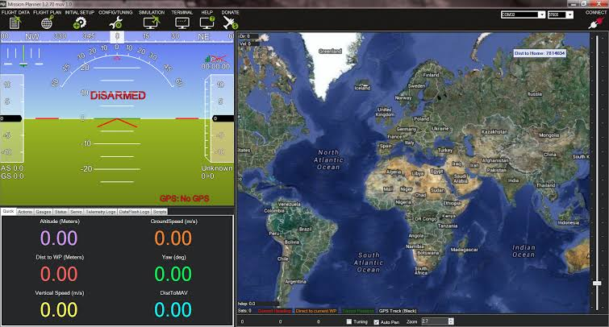
LAB WORK - HANDS-ON ACTIVITIES
Lab Work — Hands-On Activities & Ground Control
HANDS-ON ACTIVITIES
Propeller blade installation on drone
Wire management on drone
Equipment handling & support during testing
Assisted with experimentation
Assisted with Drone disassembly
MISSION PLANNER, TELEMETRY & IMU CALIBRATION
Mission Planner: Ground Control Station for ArduPilot UAVs — configuration, waypoint planning, monitoring, flight-log analysis.
Telemetry carries UAV status (position, altitude, speed, battery) to the ground station.
IMU calibration ensures accurate accelerometer/gyroscope readings — done on a stable, level surface before flight.
Mission Planner Interface
EDGE AI DEPLOYMENT PIPELINE
41

Slide 42
LAB WORK - UAV FUNDAMENTALS
UAV Fundamentals
A UAV operates without an onboard pilot — remotely controlled or fully autonomous — built from several interconnected subsystems:
Airframe
Propulsion
Flight Control
Navigation
Physical structure
Motors, ESCs, propellers
Stabilises & controls flight
GPS & positioning
Communication
Power
Payload
Ground/operator data link
Batteries & power mgmt
Cameras, sensors, mission gear
EDGE AI DEPLOYMENT PIPELINE
42

Slide 43
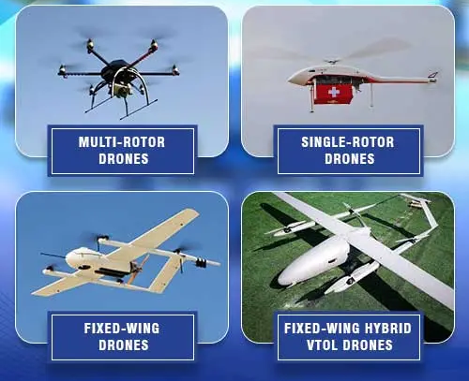
LAB WORK - TYPES OF UAVS
Types of UAVs
Type | Characteristics | Typical Use
Fixed-wing | Needs forward motion; ~1–2 hr, 60–120 km/h; no hover | Surveying, agriculture, mapping
Multirotor | Stable hover; ~15–30 min, 20–50 km/h | Photography, inspection, delivery
Single-rotor | Helicopter-like; higher payload/endurance | Heavy-lift applications
VTOL / Hybrid | Vertical takeoff + fixed-wing flight | Long-range mapping, surveillance
Apparent size, speed, altitude, and motion pattern vary considerably between types — relevant when building detection datasets.
Types of UAVs
EDGE AI DEPLOYMENT PIPELINE
43

Slide 44
LAB WORK - COMPONENTS & COMMS
Core Components & Controllers
CORE DRONE COMPONENTS
COMMUNICATION TECHNOLOGIES
M
Motors
Brushless DC — KV, thrust, efficiency
Tech | Characteristics
2.4 GHz | Good range; Wi-Fi interference possible
5.8 GHz | More responsive; shorter range
Wi-Fi | Convenient; shorter range
4G/5G | Long-distance, needs cellular coverage
E
ESC
Regulates motor speed
P
Propellers
Diameter, pitch, material, blades
F
Flight Controller
The "brain" — sensor fusion
B
Battery
Li-Po — voltage, capacity, discharge
EDGE AI LINK
AI → Sensor Data → Decision → Flight Control — supports autonomous flight, obstacle avoidance, and predictive maintenance.
EDGE AI DEPLOYMENT PIPELINE
44

Slide 45
LAB WORK - SIGNAL PATH & RF DETECTION
Control Signal Path & RF-Based Detection
1
2
3
4
5
6
7
Controller Input
Electrical Signal
RF Modulation
Wireless Transmission
Drone Receiver
Flight Controller
Motors
Capability | Purpose
RF Detection | Determine whether drone-related RF signals are present
RF Tracking | Locate the drone via its RF transmissions
RF Jamming/Mitigation | Disrupt the communication/control link
VISION VS. RF — RELEVANCE TO THIS PROJECT
This project's YOLOv7-tiny/NCNN pipeline is vision-based (detects appearance in camera frames), while RF detection senses the drone-controller radio link. The two are complementary, not interchangeable.
EDGE AI DEPLOYMENT PIPELINE
45

Slide 46
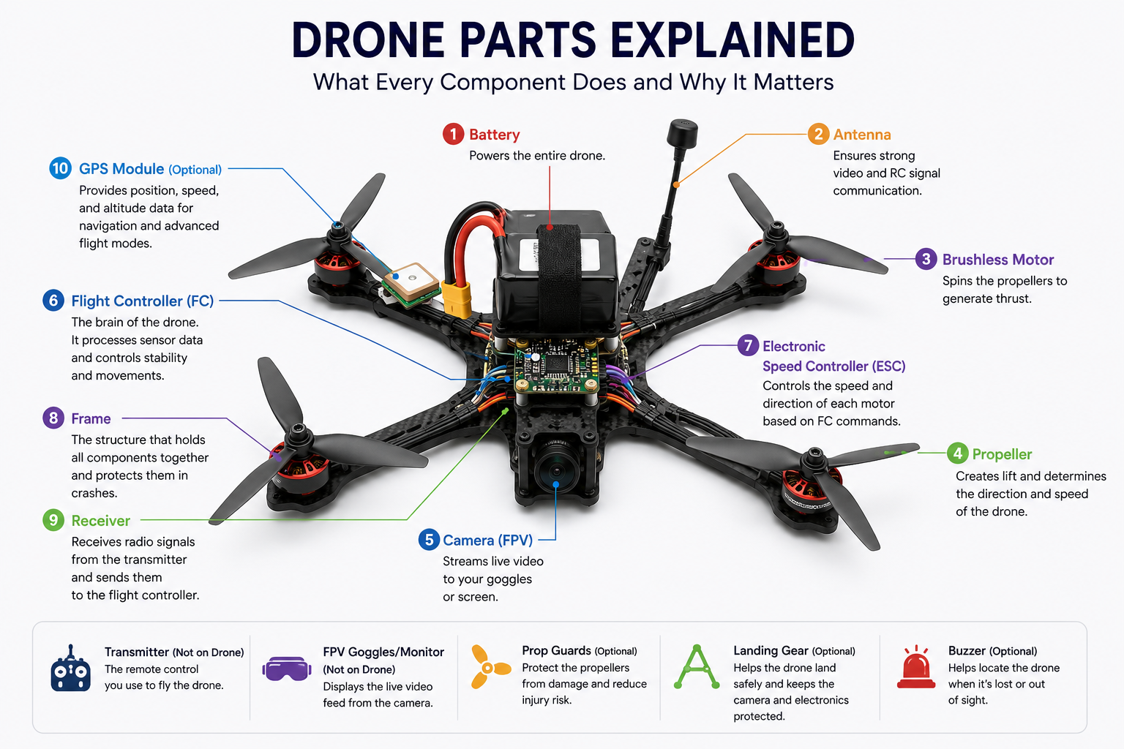
LAB WORK - COMPONENTS OBSERVED
Components Observed & Drone Manufacturing
CORE COMPONENTS OBSERVED
GPS/GNSS — positioning and navigation
Flight control board — processes sensor data, drives motors
Battery — powers propulsion, control, comms, payload
Transmitter/receiver — operator ↔ UAV link
Camera/sensors — potential AI-detection input
MANUFACTURING & CONSTRUCTION
Spans airframe design, integration, assembly, calibration, testing.
Carbon fiber common for frames — high strength-to-weight ratio.
Weight affects power consumption, payload, and endurance.
Minimum build: frame, motors, propellers, ESCs, flight controller, battery, receiver.
Drone Components
EDGE AI DEPLOYMENT PIPELINE
47

Slide 47
REFLECTION
Challenges & Lessons Learned
Spanning the research phase, both hardware case studies, the YOLO11n iteration, and cross-platform benchmarking.
Phase | Challenge | Lesson
Research | Arduino IDE instability on ESP32 | Official SDKs (ESP-IDF) offer far more control and reliability for real firmware work
Research | No OS on firmware-only boards | Environment setup (drivers, SDKs, packages) is complex — budget for it early
Research | Tight compute/memory budgets | Optimization (quantization, pruning) isn't optional — it's core to the pipeline
AMB82-Mini | Reparameterization needs a GPU | Failed on a local CPU-only machine; Kaggle's free GPU runtime worked without issue
AMB82-Mini | Undocumented PyTorch break in reparam script | Newer torch.load defaults broke the reparam script — fixed with a one-line patch
AMB82-Mini | Limited dataset size | Impacted precision/recall stability — more training data is the clearest next lever
Raspberry Pi | CSI camera stack too immature on ubuntu | USB/UVC cameras are far more portable across embedded Linux targets than CSI+ISP
Raspberry Pi | No prebuilt NCNN for this target | Budget real time for building inference runtimes from source on niche SBCs
Model Iteration | Frame-skipping broke fast targets | Latency tricks can hurt reliability — validate against the real use case, not just FPS
Benchmarking | AMB82 NPU has no timing hook | Plan for benchmarking access (timing hooks/logs) during hardware selection, not after
Overall | Same weights, very different results | Model accuracy and hardware/runtime fit are inseparable — an accurate model can still be unusable on the wrong target
EDGE AI DEPLOYMENT PIPELINE
47

Slide 48
WHERE THINGS STAND
Results
✓
✓
✓
✓
Pipeline Architecture Defined
Hardware Landscape Mapped
AMB82-Mini: Trained & Deployed
AMB82-Mini: Live Detection Verified
Build-time and run-time flow fully mapped
Capabilities & constraints compared across 3 target boards
YOLOv7-tiny drone detector, converted and flashed to NPU
Real-time RTSP detection confirmed
✓
✓
✓
✓
Raspberry Pi: Deployed & Benchmarked
Raspberry Pi: YOLO11n Fine-Tuned
Three-Way Performance Benchmark
Full Documentation Written
YOLOv7-tiny via NCNN — ~1.7–2.0 FPS, ~500–545 ms/frame
mAP50 0.896 — ~2.6–2.8 FPS, ~300–350 ms/frame (~40% faster)
AMB82-Mini (NPU) vs. Pi × 2 models (CPU) compared on speed & accuracy
Both case studies, drone fundamentals, and benchmarking sections all documented
BOTTOM LINE
The pipeline is now validated end-to-end on two hardware targets — the NPU-accelerated AMB82-Mini and the CPU-only Raspberry Pi Zero 2W — across three model configurations, benchmarked head-to-head and grounded in full drone-fundamentals research and hands-on lab work.
EDGE AI DEPLOYMENT PIPELINE
48

Slide 49
LOOKING AHEAD
Key Takeaways & Conclusion
KEY TAKEAWAYS
1
Hardware fit and optimization matters as much as model accuracy
The same YOLOv7-tiny weights ran ~4× faster on the AMB82-Mini's NPU than on the Pi's CPU — raw compute architecture dominated throughput more than any single software change.
2
Fine-tuning a nano model closes part of the gap
Swapping to a purpose-trained YOLO11n cut Pi inference time ~35% and lifted FPS ~40% over the reused YOLOv7-tiny weights — entirely from software-side choices.
3
Optimization tricks must match the real use case
Frame-skipping looked like a free win on paper but was dropped once tested against fast-moving UAV targets, where a skipped frame can miss the subject entirely.
CONCLUSION
This project has validated the same edge-AI drone-detection pipeline across two fundamentally different hardware targets — the NPU-accelerated AMB82-Mini and the CPU-only Raspberry Pi Zero 2W — and, on the Pi, across two model choices. With INT8 quantization, real-flight testing, and a formal YOLOv7-tiny accuracy evaluation as the clear next steps, the project has an evidence-based picture of the real accuracy/speed/hardware trade-offs in deploying computer vision at the edge.
EDGE AI DEPLOYMENT PIPELINE
49

Slide 50
THANK YOU
Edge AI Deployment Pipeline for Resource-Constrained Embedded Systems
EDGE AI DEPLOYMENT PIPELINE
50

